Slide 1
Chess of Champions
Group 28
Eldin Vujic - Victor Fong - Saude Chaudry

Slide 2
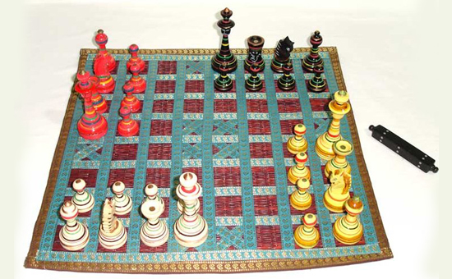
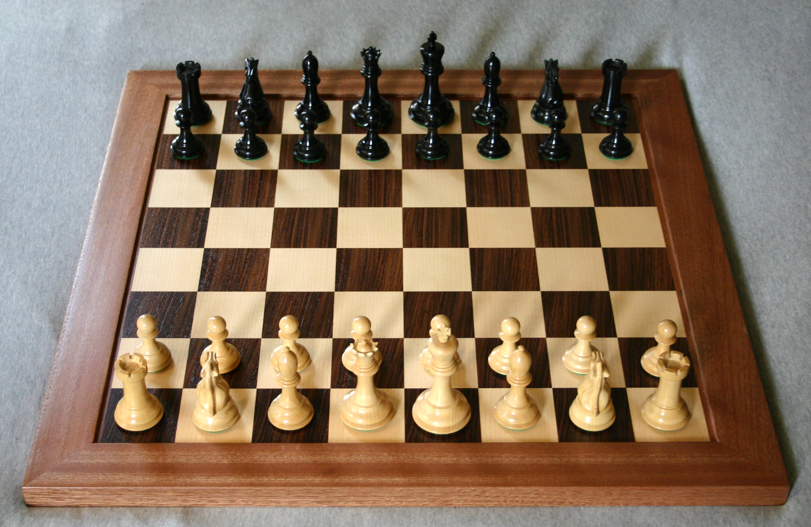
Overview:
The traditional game of Chess is a common game that is still played today that was believed to be created before the 7th century which was derived from the Indian game chaturanga. So we thought about extending this traditional game into a more modern type game.
Chaturanga
Chess

Slide 3
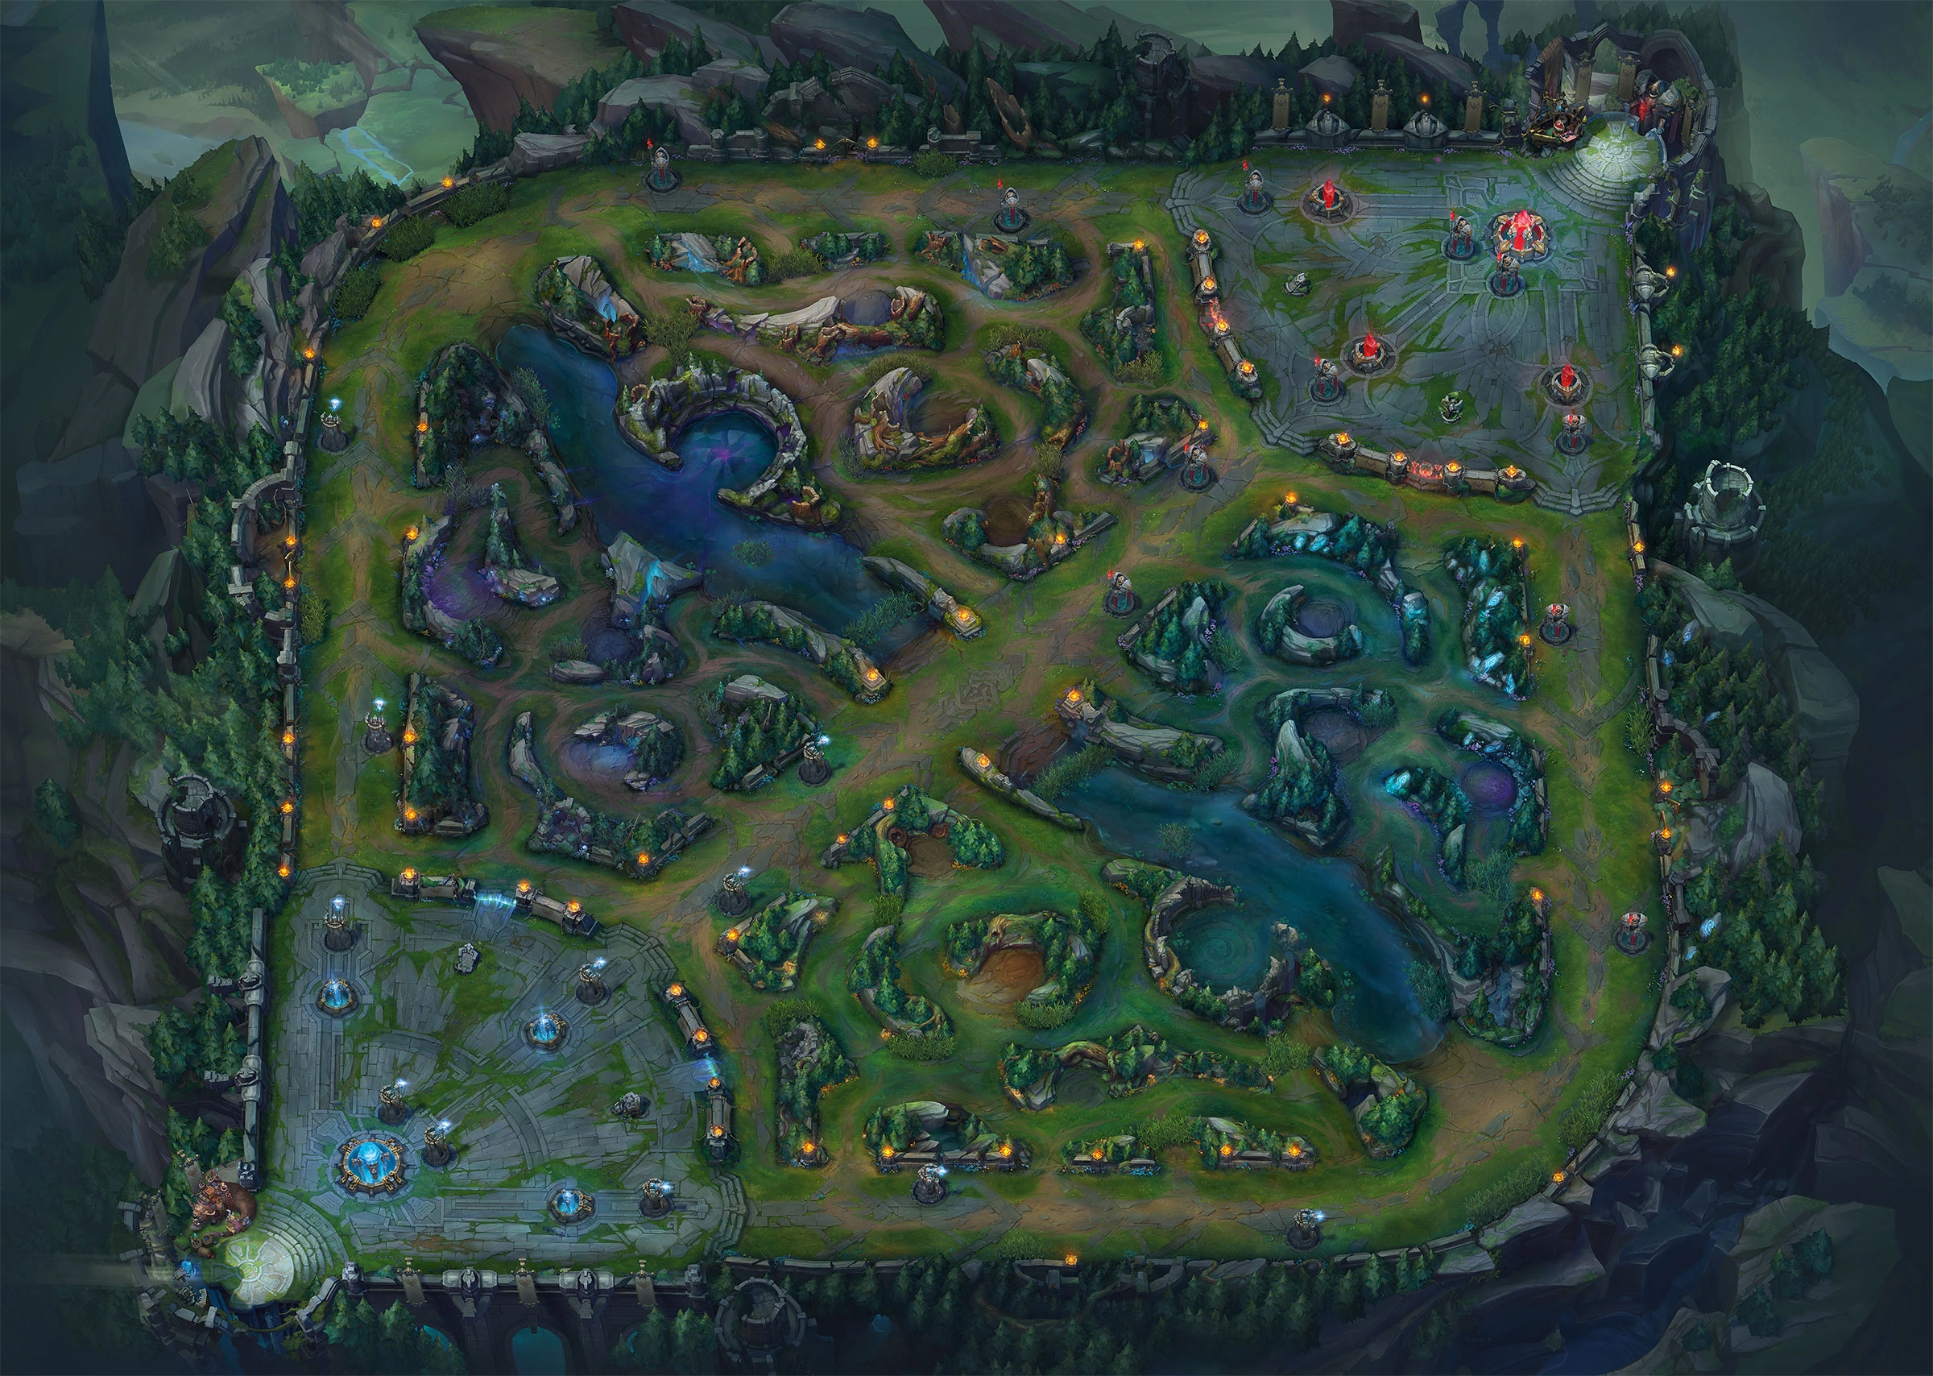
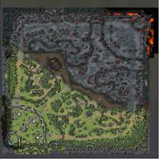
Overview:
So what better way to extend this traditional game then use concepts from a major genre known as MOBAs such as Dota 2 and League of Legends. Essentially what this game does is it extends chess into a 4 player game while using the concepts of League of Legends / Dota 2 as well.
Dota 2
League of Legends

Slide 4
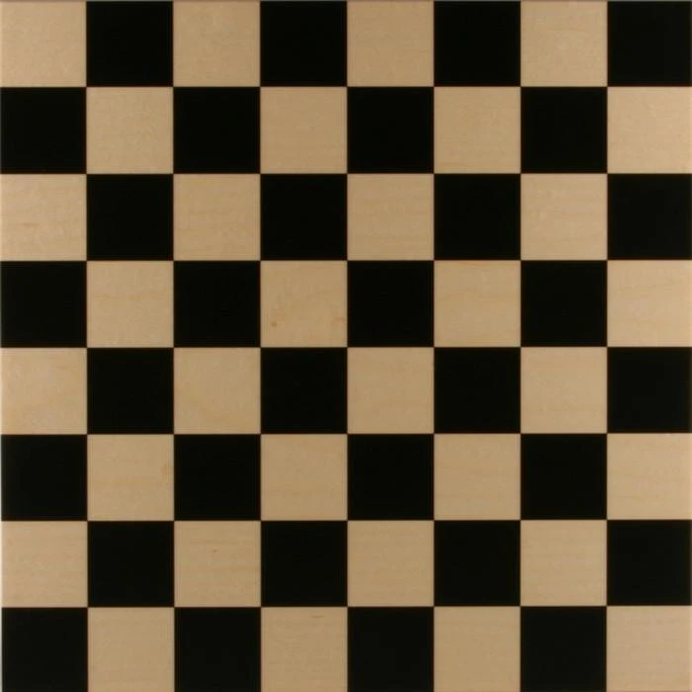
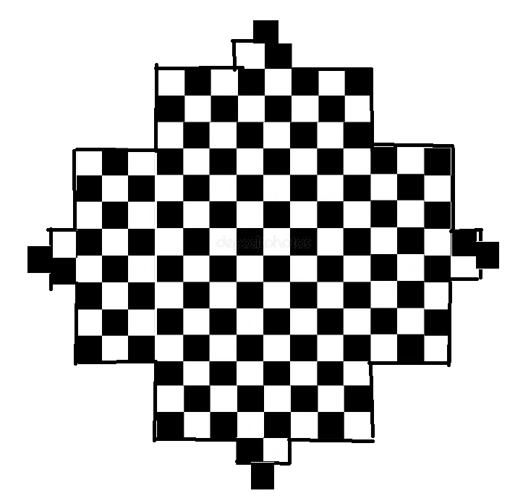
Board?
So traditionally the game of Chess has a board that is a 8x8 grid (64 tiles/spaces).
So instead of keeping this 8x8 grid (64 tiles/space) it will have a 8x8 + 4*(8x3) + 2*4 + 4 grid. So to get a better idea on how this looks the image is listed below.
Chess board
Chess of Champions Board

Slide 5
Pieces?
Chess also has the pieces, Bishop, Rook, Queen, King, Pawn, and Knight. That are all essential to playing the game. We decided to keep these essential pieces because they all play a huge role into MOBAs as well.
Since MOBAs pieces have Support, Top, Mid, ADC, Minions, and Jungler. This could be seen as (Bishop = Support, Rook = Top, Queen = Mid, King = ADC, Pawn = minion, Knight = Jungler).
But for this game of chess we decided to add 2 more pieces each of the 4 players can have, which are Tower and Base. Since in MOBA games they usually have 2 towers and a base that the player must destroy to end the game.

Slide 6
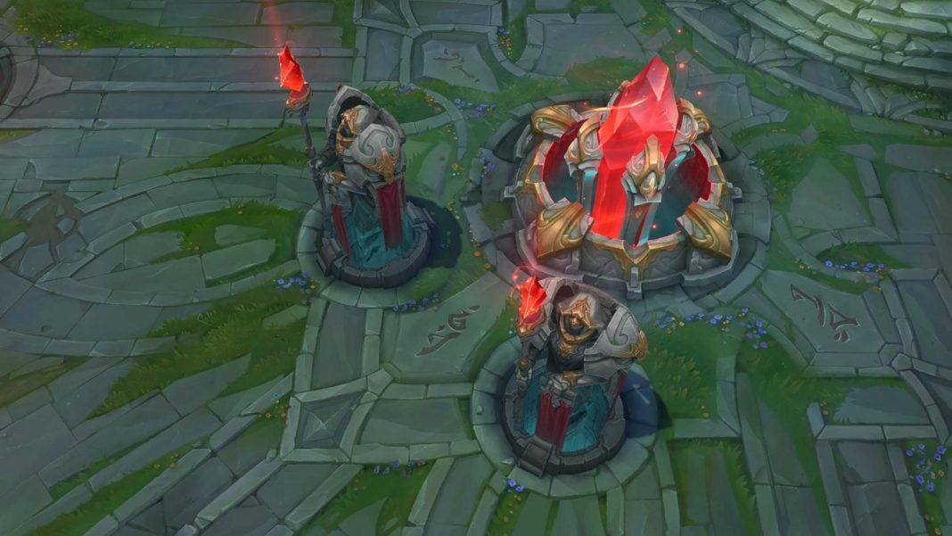
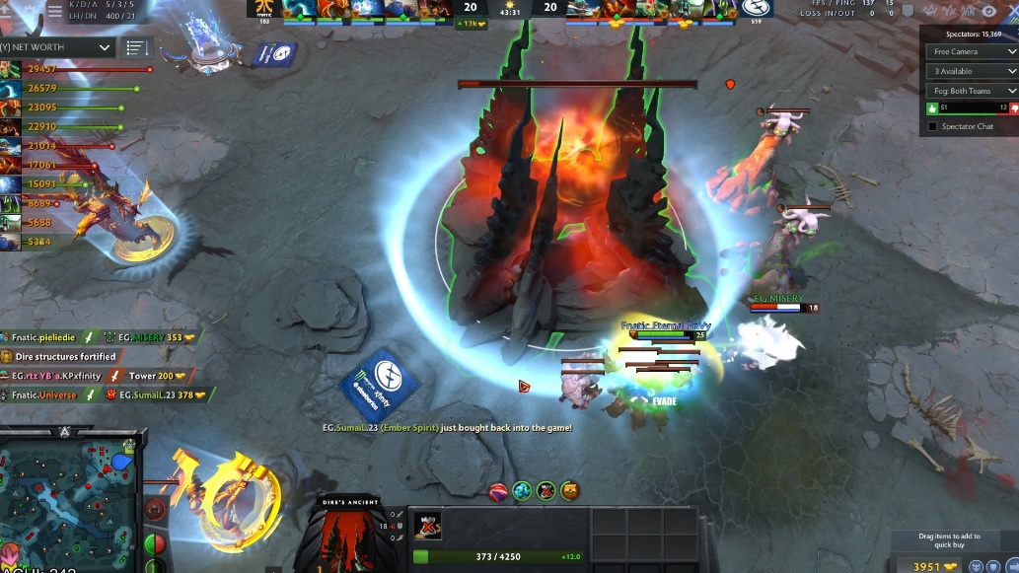
Base and Towers
League base Dota 2 Base

Slide 7
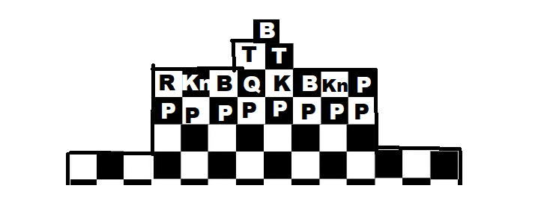
Where do the pieces go?
The pieces basically go in the same place as a standard chess board but instead it is fixated for a 4 player chess game. And also the tower and base piece goes all the way at the top most board (Shown in the picture below / This setup goes for all players).
B = Base
T = Tower
P = Pawn
K = King
B = Bishop
Kn = Knight
R = Rook
Q = Queen

Slide 8
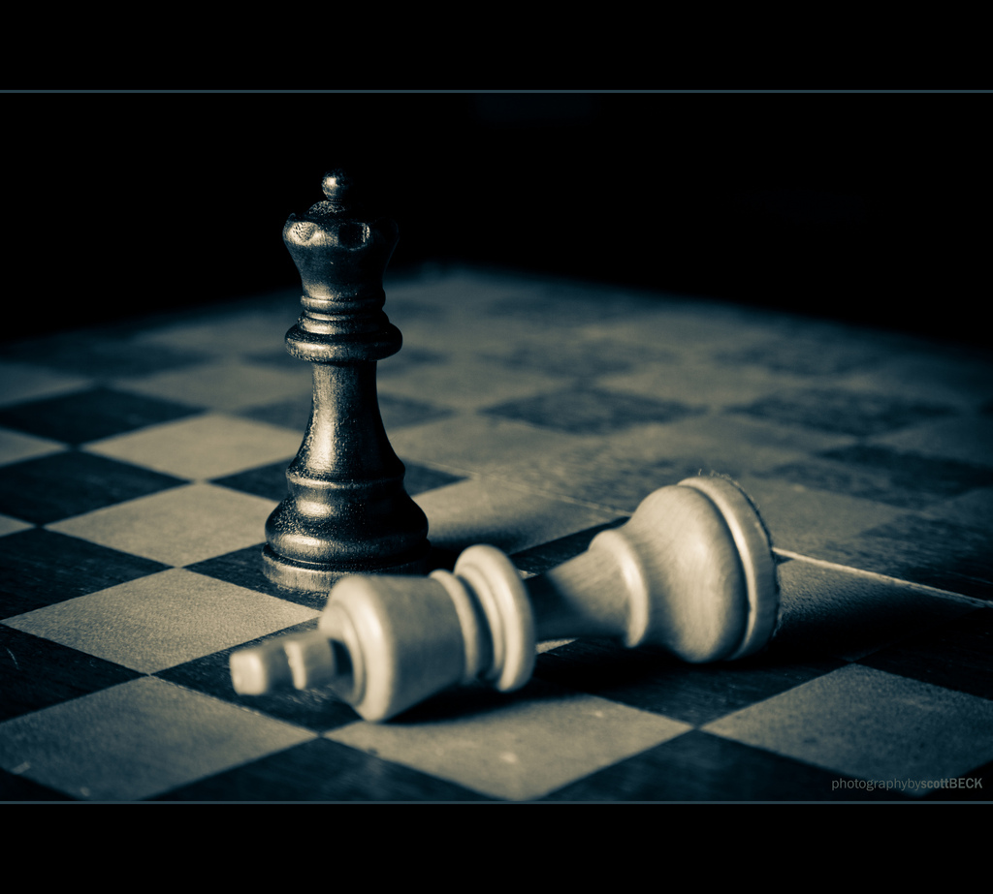
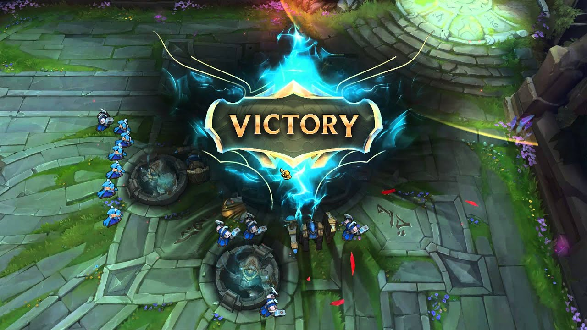
How to win?
So it is essentially the same concept as League of Legends and chess, but instead of checking the King you have to destroy the two towers of the enemy base, and then which you can destroy the base.

Slide 9
So if there is no check what do you do with your pieces?
Well as for moving every piece besides the King move standardly, but instead of them dying they can respawn in the place they are generated when the game starts. So if a queen dies you don’t lose your queen but instead, she respawns in the same spot. But this is the catch, every piece you capture with your queen or any other pieces makes the piece stronger by who they captured. So capturing a Pawn makes any piece .5 stronger because a Pawn has a hitpoint of .5. Every piece besides pawn and king have a hitpoint of .5 where Pawn starts out with a hitpoint of .5 and a king starts out with a hitpoint of 3.

Slide 10
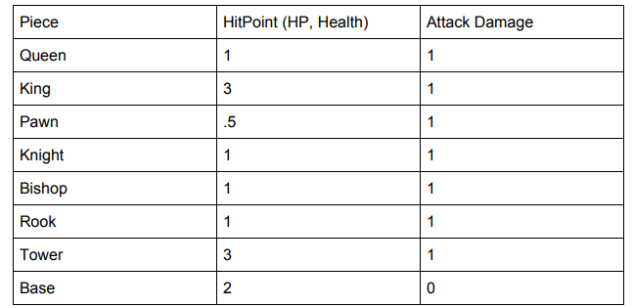
Table for Pieces and HP / AD
So basically every piece besides the king, tower, and base can be taken by any other piece.

Slide 11
Now how would you attack the tower, base, and king if you don’t have enough hitpoints?
Everytime a piece captures another piece their Attack Damage increases based on how much Hitpoints the piece they are capturing has this doesn’t include towers, bases, and rooks. Rook instead increase their Health by how much they capture someone, so if they capture a pawn instead of having 1 Hitpoint now they have 1.5 Hitpoints. As for the king if he captures a piece his attack damage doesn’t also increase but his attack range also increases becoming slowly like a queen.

Slide 12
Now how do you balance this out?
Everytime a piece dies if they’re a pawn their stats get reset and based on how many pieces they captured so for example a queen who has captured 4 pieces, you would have to wait 5 turns to get her back. This applies to the king as well but instead, his stats remain the same. Basically you would use this application/game to play a more modern style of chess and your objective is to destroy the enemy base.

Slide 13
The purpose and goal of this?
The purpose of this game is essentially extending a game traditional game like chess and adding a more modernized game to it as well while adding 4 players to chess.
The goal of this project is to test the limits that chess can have and it also tests the amount of different situations you can play chess in now. Due to having a base to defend instead of the King and the team of 4 players which can influence the pace of the game as well.

Slide 14
How would you code this?
If you could create chess in any language, you can create this game in any language.

Slide 15
Thank you.

